Slide 1

Project Data science II
Omar adel Mohamed
Sec:3

Slide 2
Baseball Teams data
Q1 | Q2 | Q3 | Q4
Data Wrangling | Exploratory Data Analysis | Data Transformations | Spending efficiency
Deal with missing data | Payroll distribution | Standardizing across years
 | Correlation between payroll and winning percentage | Expected wins

Slide 3
PART ONE: Data Wrangling
Read Table salaries using SQL :
We have two tables TEAMS and SALARY tables.
By using sqlite3.connect() , pd.read_sql_query() we can read those tables
Compute total payrolls and wining percentage .
Dealing with missing data:
We only have salary data from 1985 whereas we have data on teams since 1871,
therefore we will be missing all of the teams from 1871 to 1984 in our table.
we fill the total payrolls of these teams from their winning percentages and the average of their payrolls based on their winning percentage.
if we have any missing payroll after filing we will use dropna().
winning percentage =number of wins/number of games * 100

Slide 4
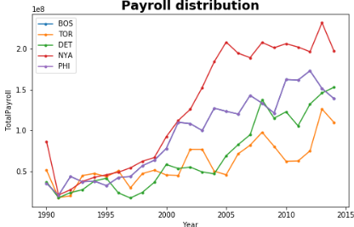
PART TWO: Exploratory Data Analysis
Payroll distribution
We illustrate the distribution of payrolls across teams conditioned on time (from 1990-2014).
the payrolls of teams are increasing over time.
Some teams become much more wealthier than the others and the difference between the wealthiest and poorest teams seems to be increasing.

Slide 5
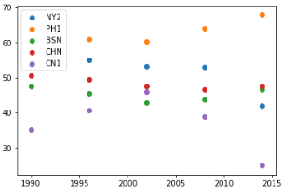
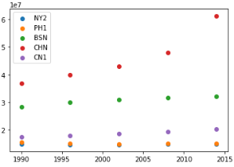
PART TWO: Exploratory Data Analysis
Correlation between payroll and winning percentage
Winning percentage across years
payroll across years
“Are there any teams that stand out as being particularly good at paying for wins across these periods?
we can see PH1 club its wining percentage above 60% however its average payrolls very small to other teams.

Slide 6
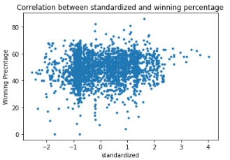
Data Transformations
Standardizing across years
We plot the winning percentage
with the transformed payroll
From plot we see how each data point
is relative to each other on a standard
scale

Slide 7
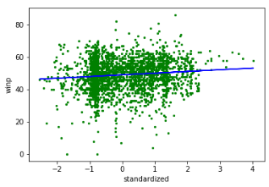
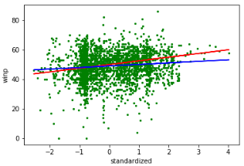
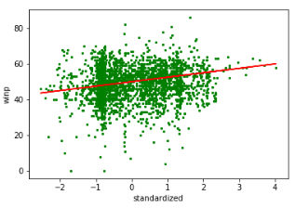
Data Transformations
Expected wins
We make linear regression model
between standardized payroll and
winning percentage and we add
the output to the scatter plot to
highlight the relationship.
The regression line gives the expected winning percentage as a function of standardized payroll for each team in each year.

Slide 8
Spending efficiency
From the expected win we can measure now the efficiency of team in each year from this equation
Spending efficiency ij= winning percentage ij - Expected wins ij

Slide 9
How good was Oakland's efficiency during the Money ball period
Oakland A’s were smart team and ahead of their time, they were thinking differently to win more than expected.
Oakland is considered an interesting team because they are an outlier to this trend.
Based of what they were paying, they were winning way more games than expected.

